Slide 1
Pruning Methods for Person Re-identification: A Survey
- Aditya Tushar Wadnerkar
(Student at San Jose State University)
Original Paper : https://arxiv.org/abs/1907.02547

Slide 2
Introduction
tremendous increase in deep learning architectures
visual based recognition such as person re-identification
computational complexity of CNNs hinders the deployment of Deep Siamese networks
pruning can drastically reduce the complexities in network
pruning reduces the number of FLOPS required by ResNet feature extractor

Slide 3
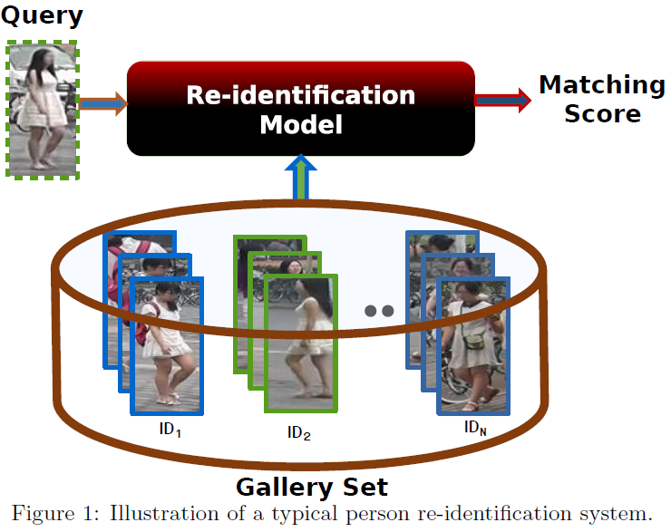
CNNs have achieved state of art accuracy at cost of high complexity

Slide 4
Siamese Networks
used for biometric authentication where two sub networks share weights
trained with labelled data extracting features from input images and performing pairwise matching

Slide 5
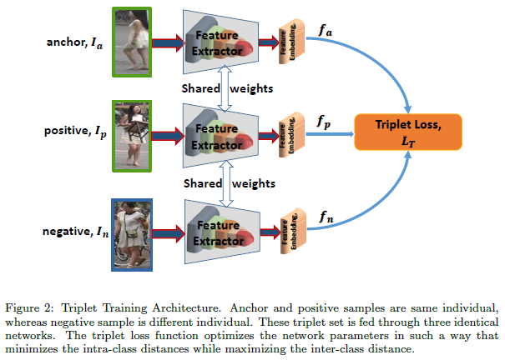
VGG, Inception, ResNet and DenseNet can be used as feature extractor
ResNet18 and ResNet34 being shallow CNNs provide lower re-identification accuracy

Slide 6


we randomly sample a triplet {Ia, Ip, In}, where, (Ia, Ip) is a pair of images of the same individual, and (Ia, In) is that of different individual
corresponding features from the backbone networks are fa, fp and fn
to form batches by randomly sampling a person, and then sampling number of images of each person
selects the hardest positive and the hardest negative samples within the batch
forming the triplets for computing the loss

Slide 7
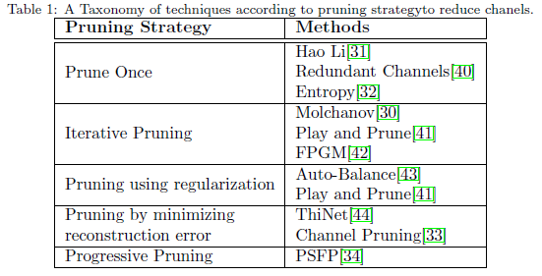
CNN Pruning Techniques

Slide 8
Comparing Algorithms

Slide 9
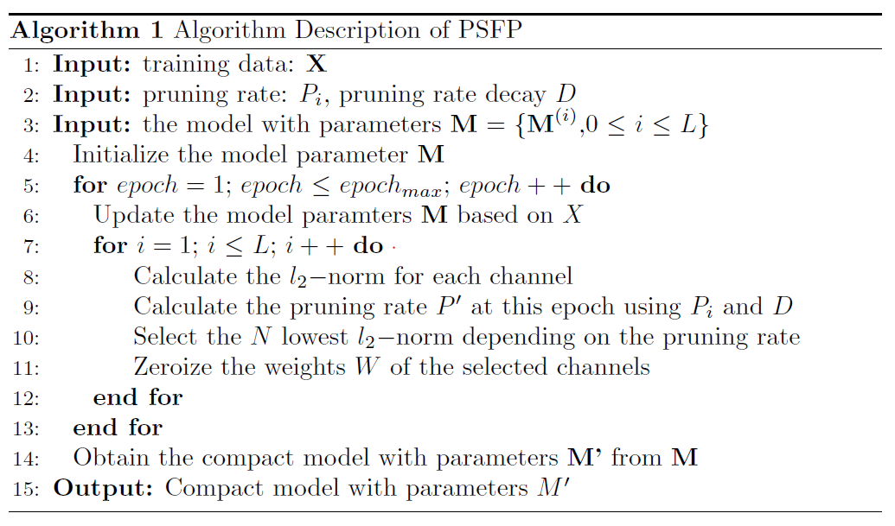
PSFP pruning scheme

Slide 10
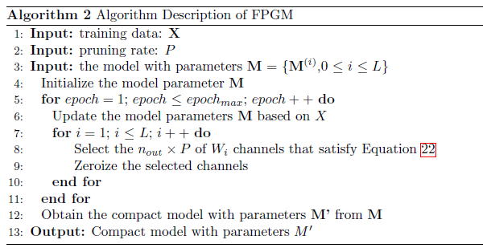
FPGM pruning scheme

Slide 11
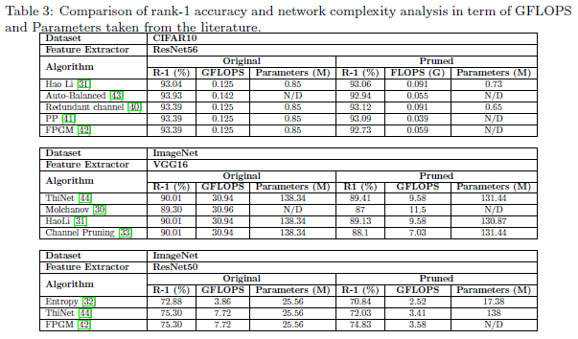

Slide 12
Adaptive Filter Pruning
The Adaptive Filter Pruning (AFP) module and the Pruning Rate Controller (PRC). The goal of the AFP is to minimize the number of output channels in the model while the PRC tries to maximize the accuracy of the remaining set of output channels. This technique considers a model M can be partitioned into two set of important channels I and unimportant channels U.

Slide 13
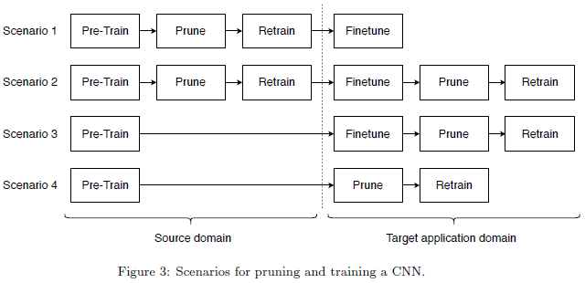

Slide 14
Datasets
ImageNet
Market-1501
CUHK03-NP
DukeMTMC-reID

Slide 15
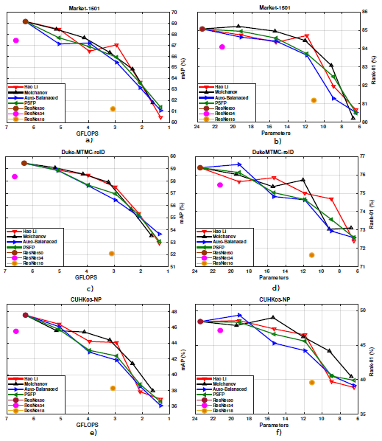
Performance Analysis

Slide 16
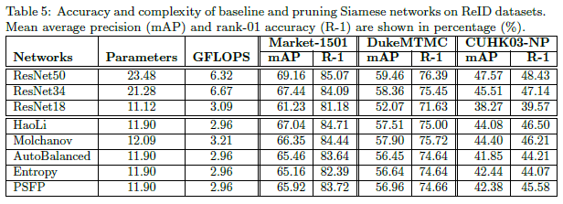

Slide 17
Conclusion
discussion about different state-of-art pruning approaches suitable for compressing Siamese networks for person Re-identification
pruning can considerably reduce network complexity (number of FLOPS and parameters) while maintaining a high level of accuracy
pruning larger CNNs can also provide a significantly better performance than fine tuning the smaller ones
both fine tuning and pruning should be performed in the same domain

Slide 18
THANK YOU

